Slide 1



Low-skilled labor migration:
Measuring Migration Costs
KNOMAD
The World Bank

Slide 2
Outline
Objective of KNOMAD work on measuring migration costs
Measuring migration cost through migrant surveys
Stylizes facts on migration costs
Migration cost questionnaire ready for public use

Slide 3
KNOMAD Work on Measuring Migration Cost
No comprehensive data on migration cost available
To build a database on migration cost (bilateral matrix), comparable across migration corridors
To help better understand the structure of migration cost and the extent of fees paid to private recruiters and agencies.
To contribute to setting a global target to reduce recruitment costs, part of SDG – e.g., to reduce to one-month wage.

Slide 4
Measuring migration costs through migrant surveys
Phase I (2013/4, completed):
  Pre-pilot survey in Spain,
  Pilot survey in Kuwait and Korea.
Phase II (2014/5, on-going):
  Returnee surveys in Ethiopia, India, Nepal, Pakistan (ILO) and the Philippines.
  Migrant surveys in Malaysia (ILO) and Mexico
  Using CAPI, building capacity of local researchers
Phase III (2015/6, planed): Survey part of national labor force survey in selected countries.

Slide 5
Which migration costs are we measuring in the migration cycle?
Employers request permission
Employers issue job orders to recruiters
Job orders arrive in labor sending countries
Deployment process
Employment
Return/ reintegration/ redeployment

Slide 6
What constitutes migration cost in the deployment process?
Compliance cost
  National documents: Passport, visa
  Security-related: Medical check-up, security clearance
  Skills/competency-related: Language test
  Welfare fund membership
Transportation cost
  Internal transportation cost to obtain required documents.
  International transportation cost to cross borders.
Recruitment service fees paid to recruiters/ other service providers (e.g., learn about job)
  Incur possibly owing to information asymmetry.
  A possible intervention area to correct market failure.

Slide 7
Wage in destination - a mechanism to reduce recruitment costs
Destination | Origin | Recruitment costs | Earnings in destination | Recruitment costs in months of earnings | Prior earnings in origin country (month)
Korea | Indonesia | 1,506 | 1,394 | 1.1 | 219
Kuwait | India | 1,248 | 494 | 2.5 | 192
Spain | Ecuador | 1,046 | 1,300 | 0.8 | 132
UAE | Pakistan | 2,148 | 387 | 5.6 | 140

Slide 8
Well-managed migration policies can result in low variation across origins

Slide 9
To Korea, key cost components are transportation and language test (average, US$)

Slide 10
Spain – Below one-month wage ($1,300), largely for international transportation

Slide 11
Implementation of BLAs – a tool to lower recruitment costs
Female domestic helpers – paying less than males,

Slide 12
Kuwait – Seven times as much as average monthly earnings ($462)

Slide 13
Qatar – between 1~ 2.5 month-earnings ($588/month)

Slide 14

Saudi Arabia

Slide 15
Bangladesh/ Pakistan – high visa fees (visa trading)

Slide 16
India/ Philippines – relatively high recruitment agency fees

Slide 17
Ensure workers migrate through regular channels

Slide 18

Migration cost questionnaires – Available on-line

Slide 19
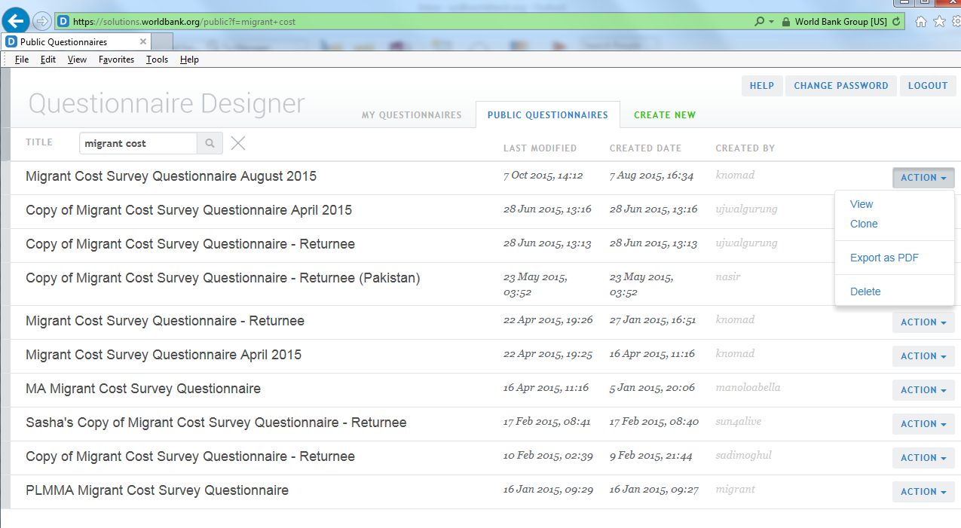
Migration cost questionnaires – Available on-line

Slide 20
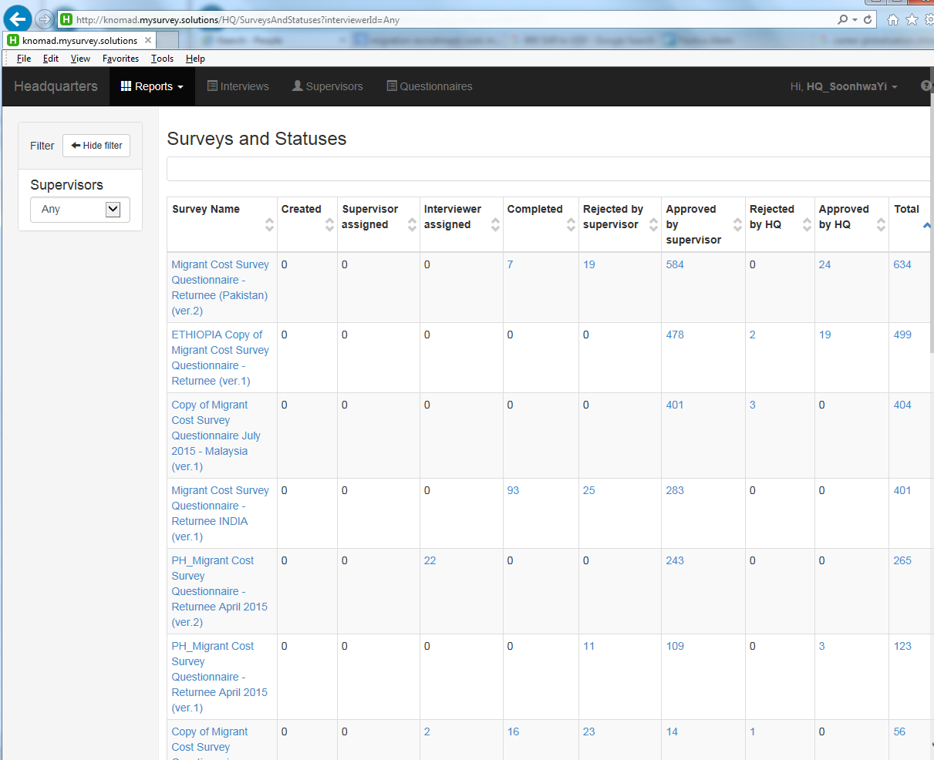
Interviews managed on-line and in-time

Slide 21
Thank you
For further information, please contact
manolo.abella@gmail.com
martin@primal.ucdavis.edu
syi@worldbank.org

